Slide 1
Intermediate Code Generation

Slide 2
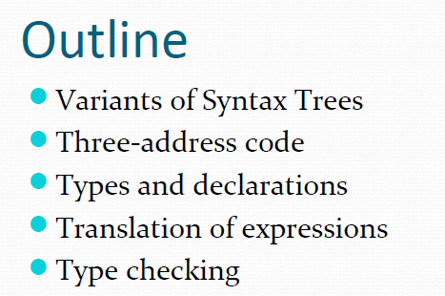

Slide 3
1. Variants of Syntax Trees
1.1 Directed Acyclic Graphs for Expressions
1.2 The value number method for Constructing DAGs
2. Three Address Code
2.1 Address and Instructions
2.2 Quadruples
2.3 Triples
2.4 Static Single – Assignment Form
3. Types and Declarations
3.1 Type Expressions
3.2 Type Equivalence
3.3 Declarations
3.4 Storage Layout for Local Names
3.5 Sequence of Declarations
3.6 Fields in Records and Classes

Slide 4
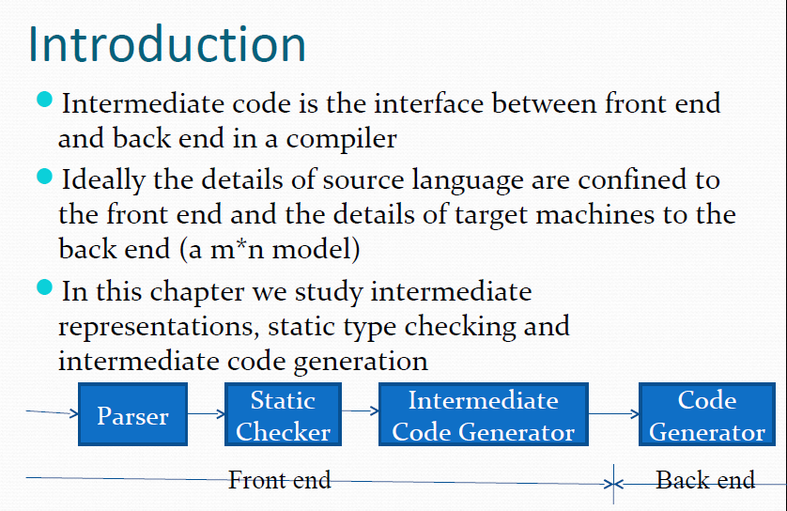

Slide 5
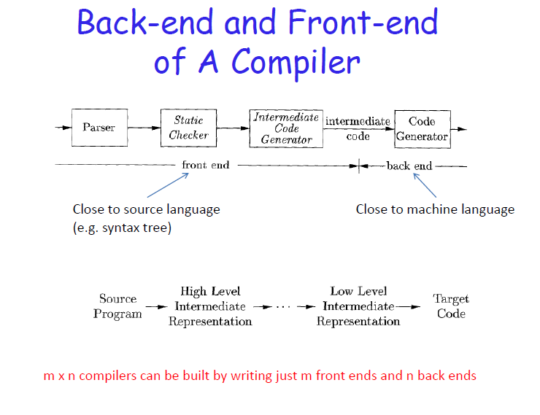

Slide 6
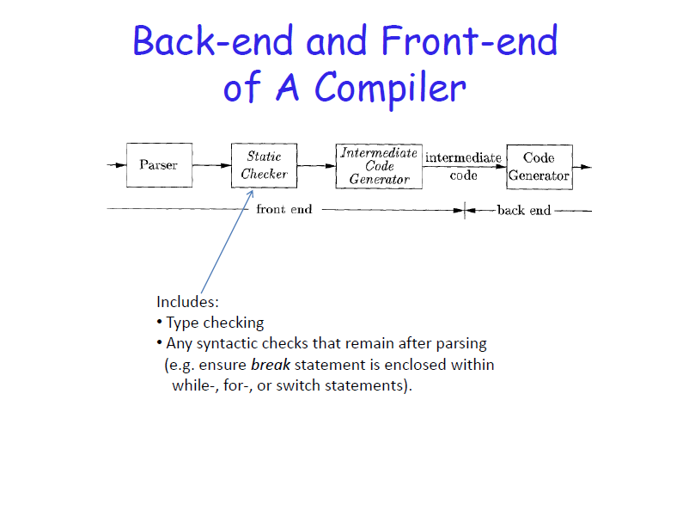

Slide 7
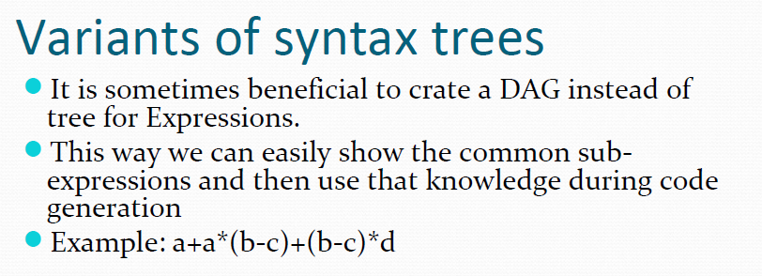
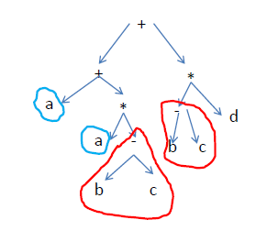
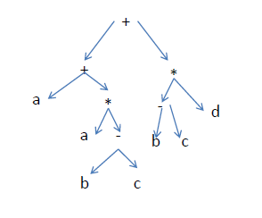

Slide 8
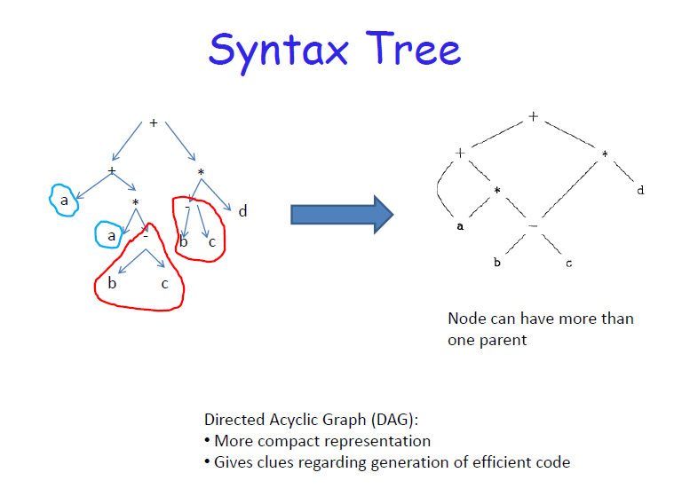
DAG

Slide 9
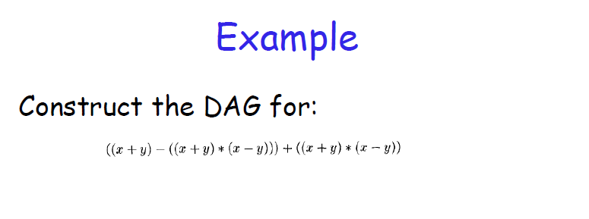
a + b + ( a + b )
a + b + a + b
a + a+ (a + a+ a+ (a + a + a + a +) )

Slide 10
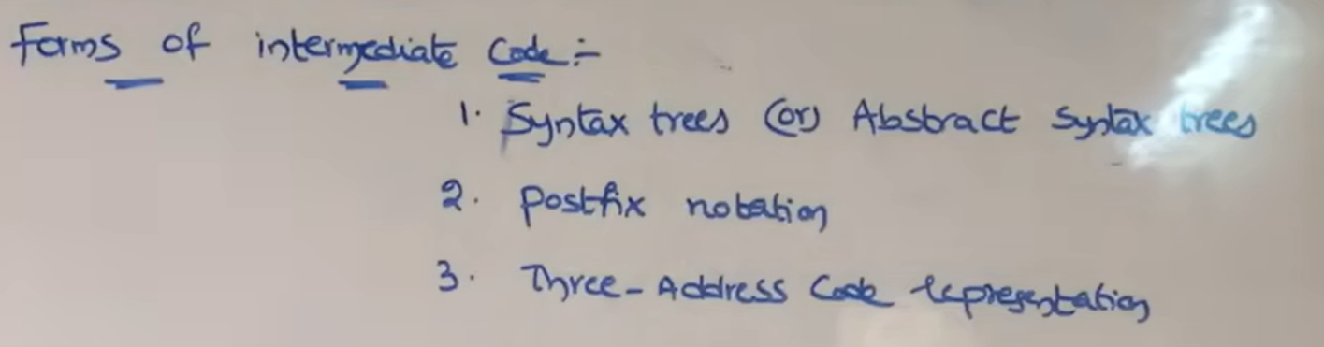

Slide 11
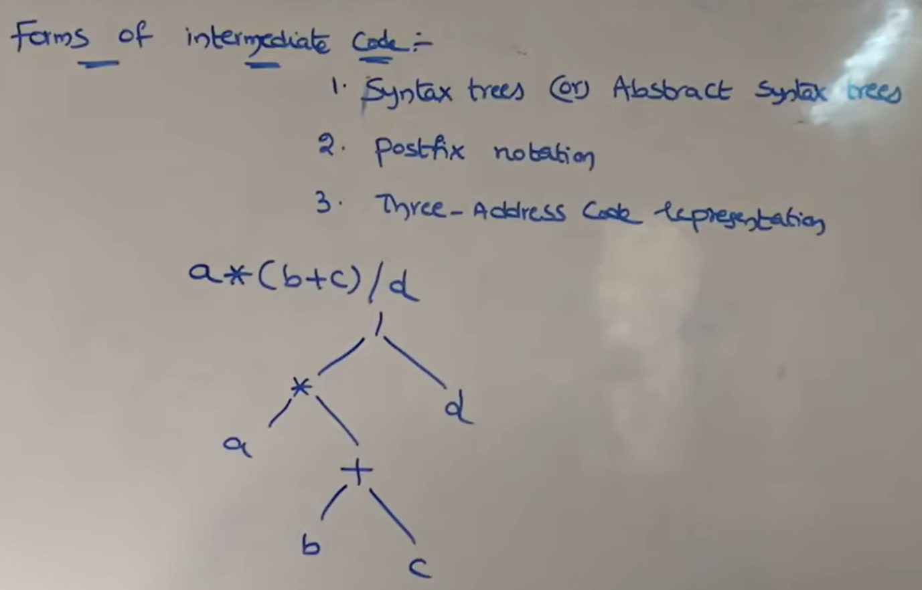

Slide 12
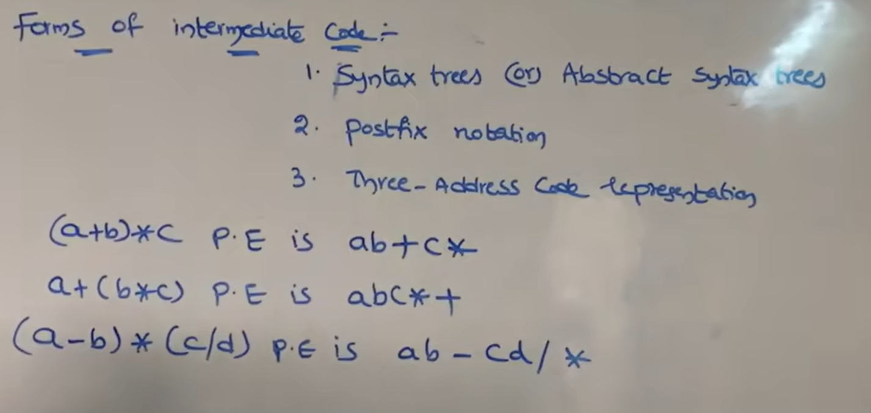

Slide 13
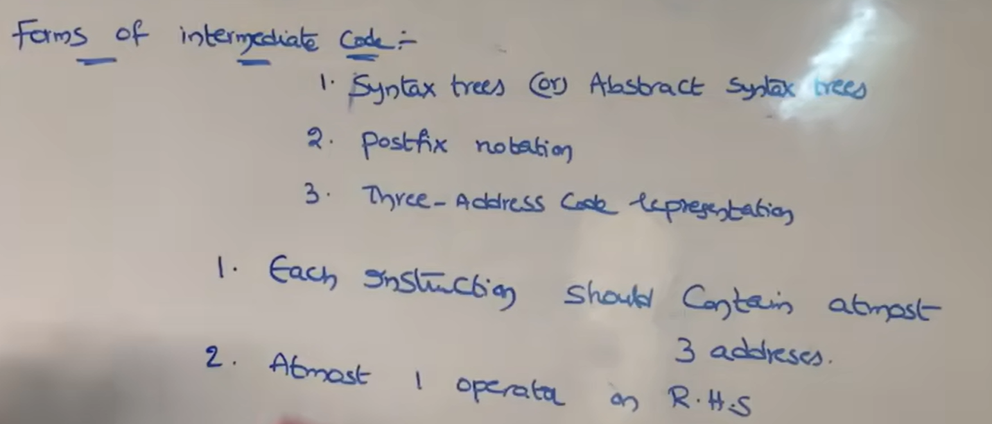
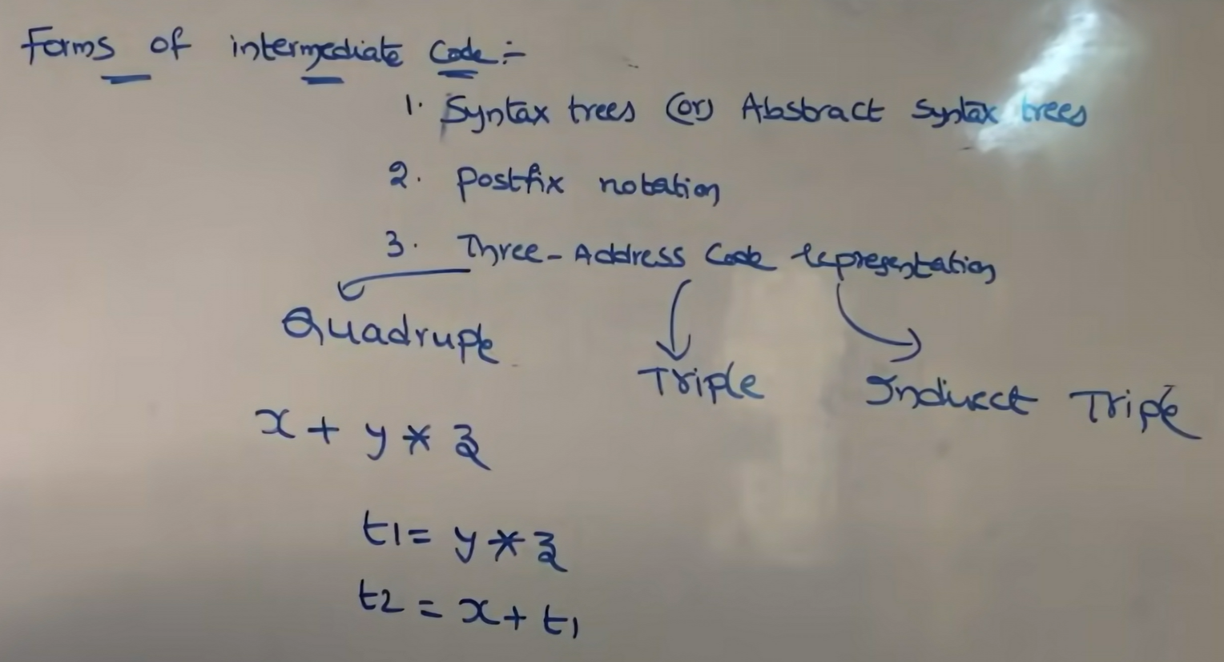

Slide 14
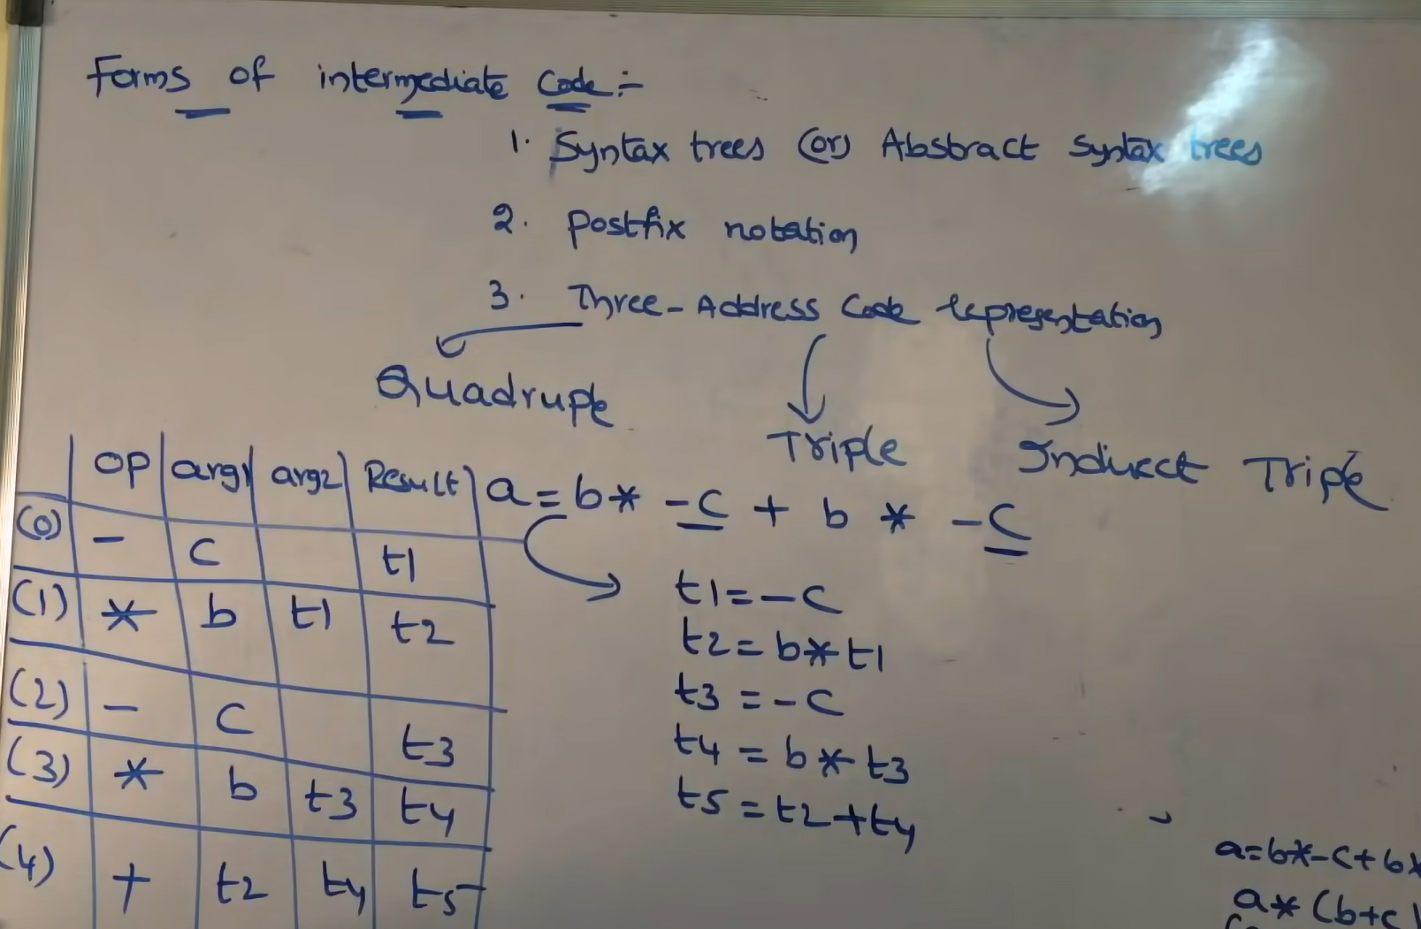

Slide 15
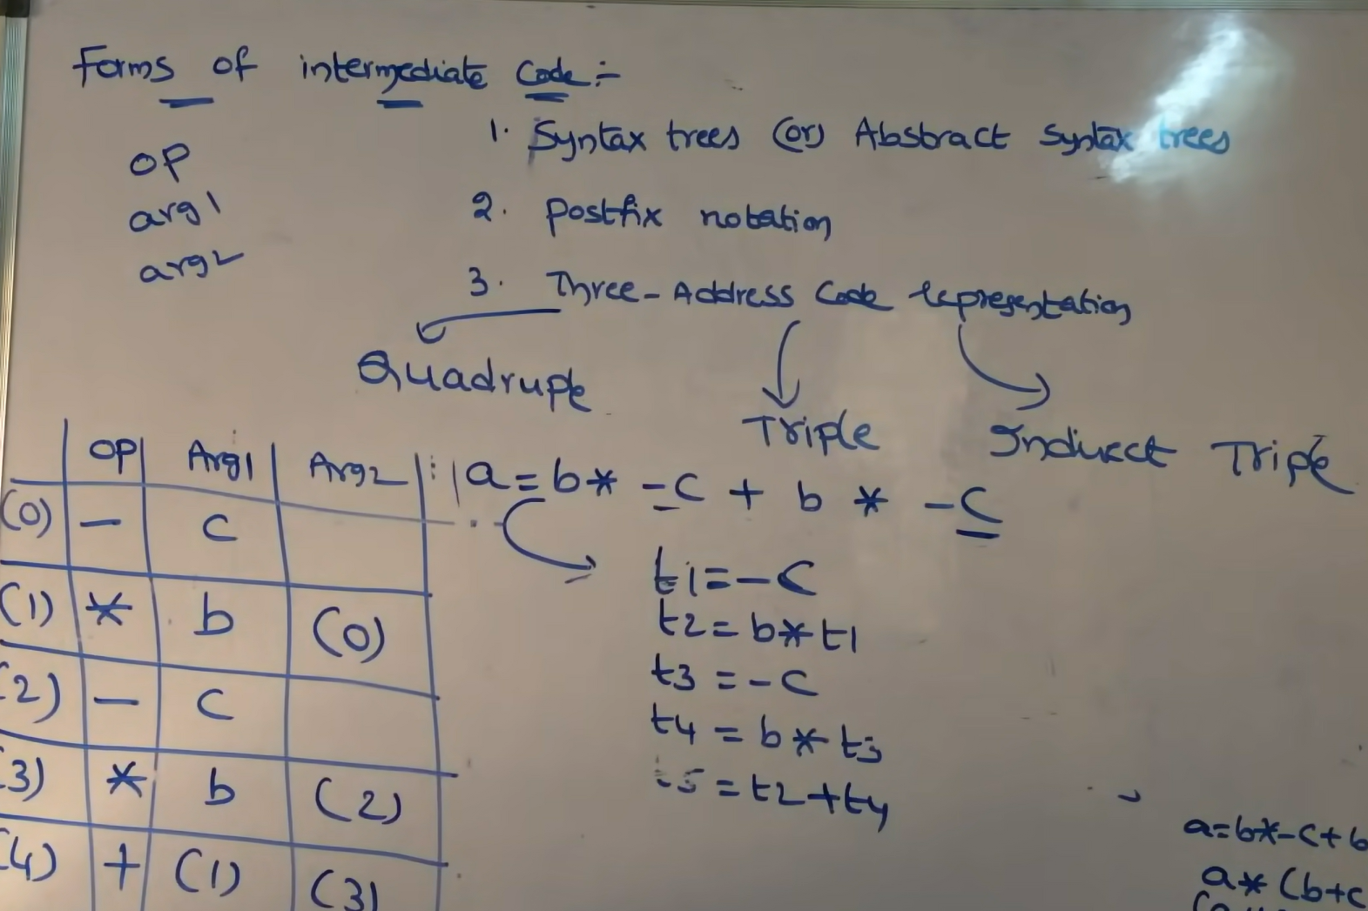

Slide 16
